Slide 1
Beyond the Diploma
The Case for ROI-Based Tuition Fees
Notes:
As we embark on the educational journey, we're often filled with hopes and dreams. We see college as a hot air balloon that will lift us to new heights, new careers, and a prosperous future. This balloon—symbolized by the cap and gown of graduation—represents the aspirations of every student entering the realm of higher education.

Slide 2
$1.74 trillion
Student loan debt is hitting record highs in 2023
Notes:
However, the uplifting journey of education has a weight attached to it—a financial anchor in the form of student loan debt. In 2023, that weight has reached a record-breaking $1.74 trillion. Each pencil in this cup, each book on this shelf, represents thousands of dollars that students will have to pay back, long after the final page of their college chapter has been turned

Slide 3
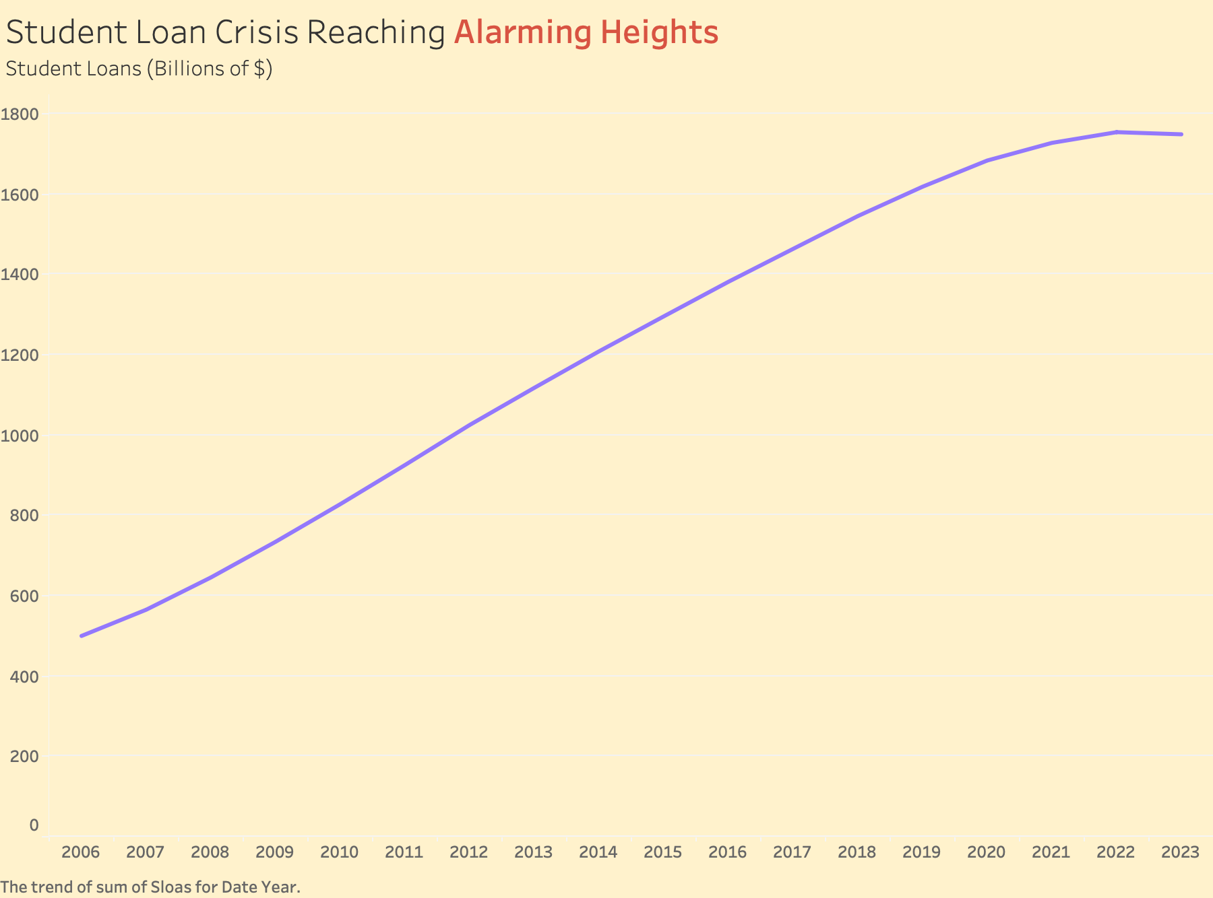
$1.74 Trillion

Slide 4

Rethinking Tuition: Making the Case for Fairer, ROI-Based Tuition
Notes:
Our presentation aims to convince you that standardized tuition is detrimental to both students and institutions. By embracing ROI-based tuition, we advocate for a system that equitably matches educational costs with the realistic economic outcomes of different majors, potentially safeguarding students from excessive debt and colleges from financial imbalance

Slide 5
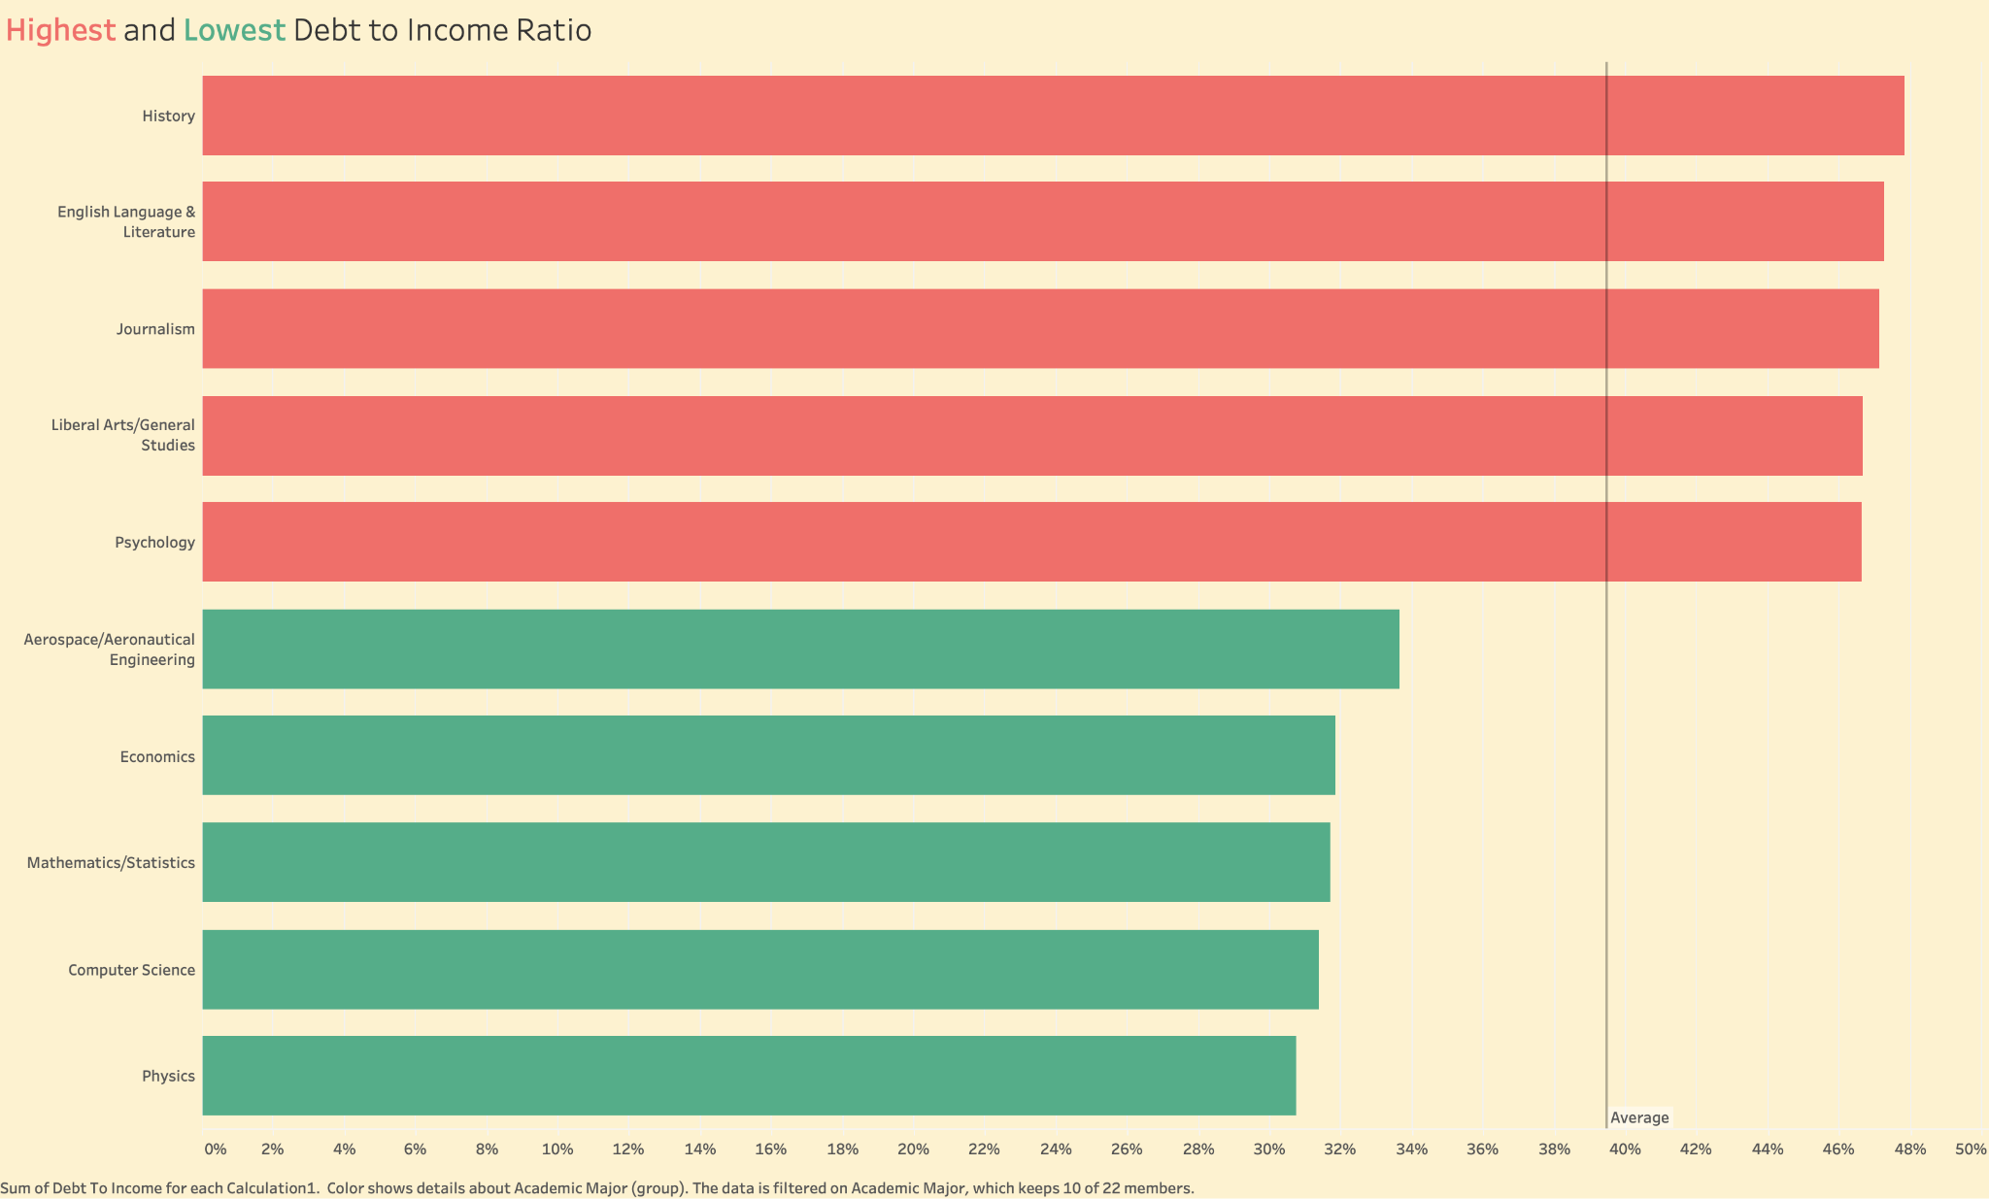

Slide 6

(History Major) ->

Slide 7
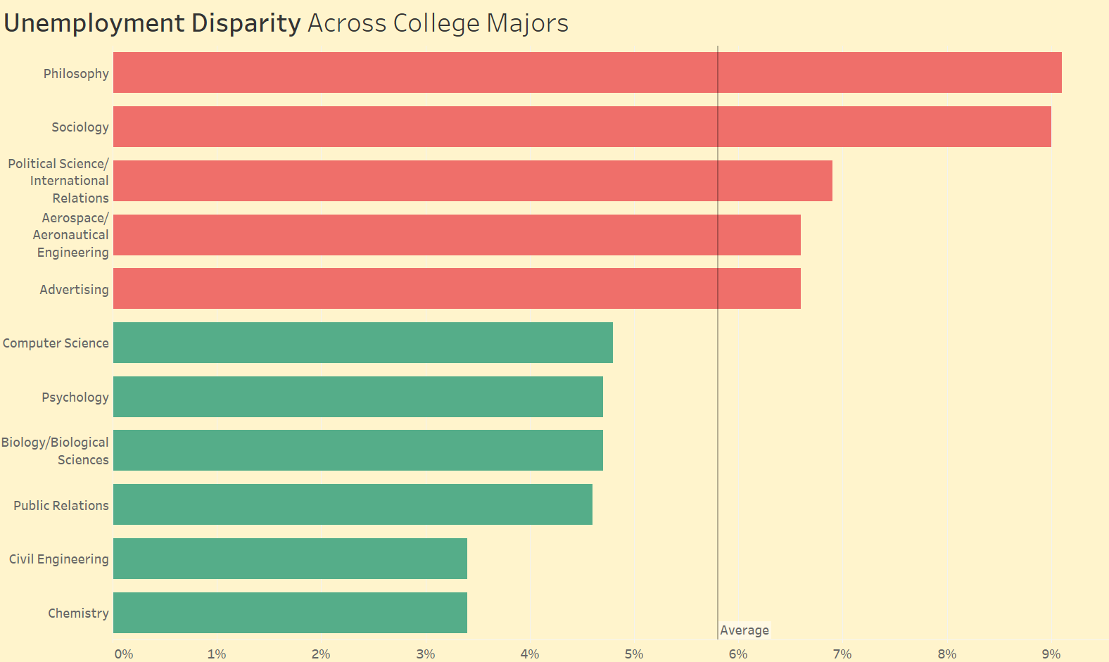
CONTENTS OF THIS TEMPLATE
(unemployment rate in %)

Slide 8
Case for ROI Based Tuition
HISTORY
CURRENT TUITION
CURRENT TUITION
COMP SCI
DEBT TO INCOME
DEBT TO INCOME
$ 32,808
$33,024
47.82%
31.38%

Slide 9
Recommendations and Their Outcomes
Differential Pricing
Helps Economy
Greater Happiness
Based on expected salary
More discretionary spending & better financial stability
Financial Freedom Fuels Well-Being

Slide 10
THANK YOU!

